Slide 1
SpaceSense – LivSpace Hack
Team Seizure – Aashish, Prasanth, Nikhil, Rahul

Slide 2
Team Introduction
Aashish Chaubey: Full Stack Developer
Prasanth Gelli: Machine Learning
Raja Rahul: Full Stack Developer
Nikhil JSK: Data Scientist

Slide 3
Problem Statement
What: (Phase 1)
Clustering and Predicting the Class (Category) of the user based on the various parameters
Grouping like minded people together in order to recommend similar items
Leads to enhance the ‘Recommendation Engine’
Predicting the class of most likely customers to sell a particular product group
Calculating the confidence score of the customer to buy the product he selects
Correlation of variables like Income, number of cities he has lived in and four others
Tried using Fuzzy Logic on these variables
Results in forecasting the estimated budget for the user against the items he has added
Annotation of the images automatically
Huge Data already exist, an attempt has been made to annotate these images on various categories
This reduces the mundane work of human interaction

Slide 4
Problem Statement
What: (Phase 1)
Annotation of the images automatically
Huge Data already exist, an attempt has been made to annotate these images on various categories
This reduces the mundane work of human interaction
Recommendation Engine
Based on the results of the model, a recommendation engine has been set up for suggest the users based on the aforementioned variables and categories in which we classify the users
The recommendation is for the entire set of interiors

Slide 5
Data Synthesis Seizure
Explaining the approach

Slide 6
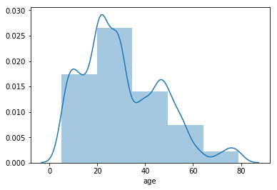
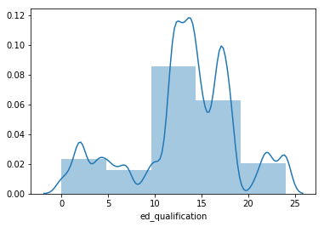
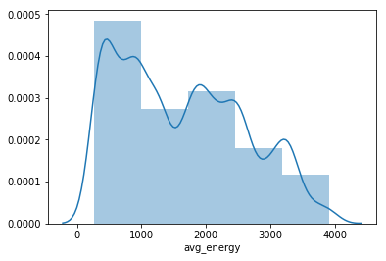
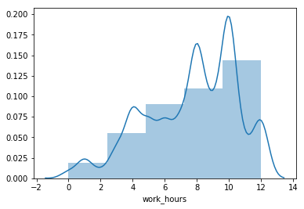
Curated Data Quality (Sample)

Slide 7
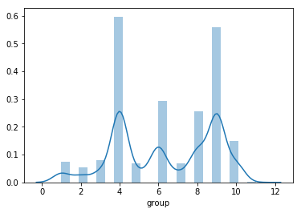
Cluster Distribution Plot
Each cluster consists of the like-minded people together
The distribution graph depicts the population distribution among clusters
Cluster-4 which represents “upper-middle class” constitutes to the larger proportion

Slide 8
Title and Content Layout with Table
Describe some of the important variables in the curated data set
It clearly shows how closely it is made to simulate the real world data
It is important to note that, we also have induced some bias wherever necessary for the same reason
Class | Mean | Std
Marital Status | 0.721200 | 0.944436
Age | 30.888000 | 16.462429
Outing | 0.983000 | 0.810664
education | 13.312300 | 5.176509
Work hours | 7.501600 | 3.023229
Other props | 2.444800 | 1.696184

Slide 9
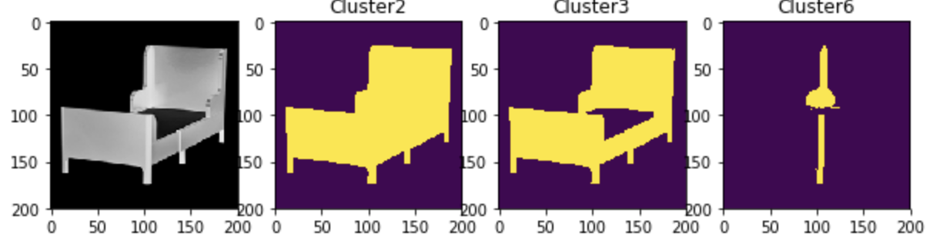
Image Segmentation
Fuzzy Logics
C - means

Slide 10
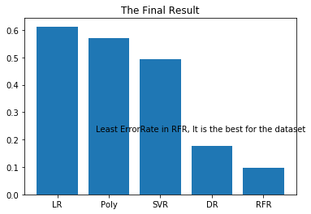
Error rate among different algorithms
Error rate among Linear Regression, Polynomial, Support vector regression, Decision tree and Random Forest regression
Least error is achieved with Random forest regression with a value of 0.1

Slide 11
Problems Focused On
Analyzing the scope of the work and what we achieved

Slide 12
Problem Statement
What: (Phase 2)
Collaboration of multiple designers from across the various geo-locations for a common user requirement
The user then selects from a list of that suggestions from the various designer catalog
The user customizes his requirement in true sense
Integrating the cash flow during the entire process
Here the main idea is to break the payments in part
This will keep the user interested in all stages as he keeps a watch on the entire supply chain

Slide 13
Uniqueness in our approach
Curating our own data set
A set of 23 parameters has been chosen to curate the data sets
The selected parameters are pertinent even in real life
Normalizing it to match the real world data set
A skewed gaussian distribution was achieved (Shown in the following slides)
This helps in a very normal distribution that helps enriching the quality of the data
Multiple models has been used for the classification and recommendation engine
A significant accuracy was noted (Error being 0.1)
The problems of the mentors has been noticed and an attempt has been made to solve it.
We reuse of one of the model for image processing we already worked on.
Note: As we have curated the datasets, we do not cite any dataset, and no cleaning of the data sets were required

Slide 14
Other Important Ideas
Wishes to: Renovation of the new homes
Want to: Customizing the current space for living
Focus on: Supply Chain
Solving the problems the customers create using the tool intended to improve the collaboration between Designer and customer
Problem: Most of the time the customers do not know what to buy
Looking for exactly what kind of a shower

Slide 15
Other Important Ideas
Idea: Platform of Collaboration for designing where in people are coming together from different geo-space to be freelancers in this
Can work on: Integrating the financial supply
Can we work on:
Changing the design and particular at a micro level
Working closely with the construction company to customize the floor plan
keeping the customer always informed with the progress of the work and always kept in the loop
Customer satisfaction tool

Slide 16
Two Content Layout with SmartArt
UI-UX : React 16
Server : Node-Express
Database : CouchDB
Model’s : Python Runtime
UI
Server
DB’s
Model

Slide 17
Add a Slide Title - 2

